Slide 1

SHAALA SIDDHI
WEB PORTAL

Slide 2


HOME PAGE - https://shaalasiddhi.niepa.ac.in

Slide 3

LOG IN SCREEN
USERNAME = SCHOOL UDISE+ CODE
Password chu Teacher/Staff i/c ten an hre turah ngaih a ni.
Password theihnghilh te chuan District Office/State Project Office-ah i/c te biak tur a ni.

Slide 4
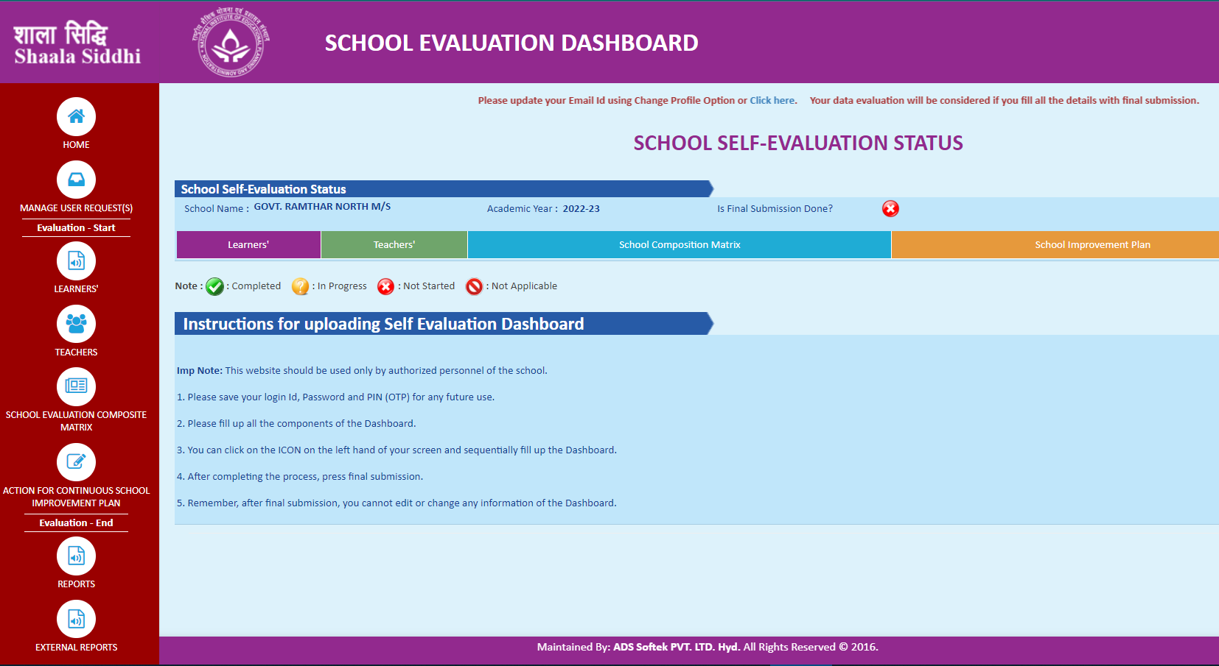
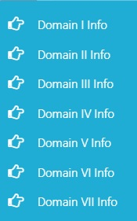
Learners
Teachers
School Evaluation Composite Matrix (Domain I to VII)
School Improvement Plan

Slide 5
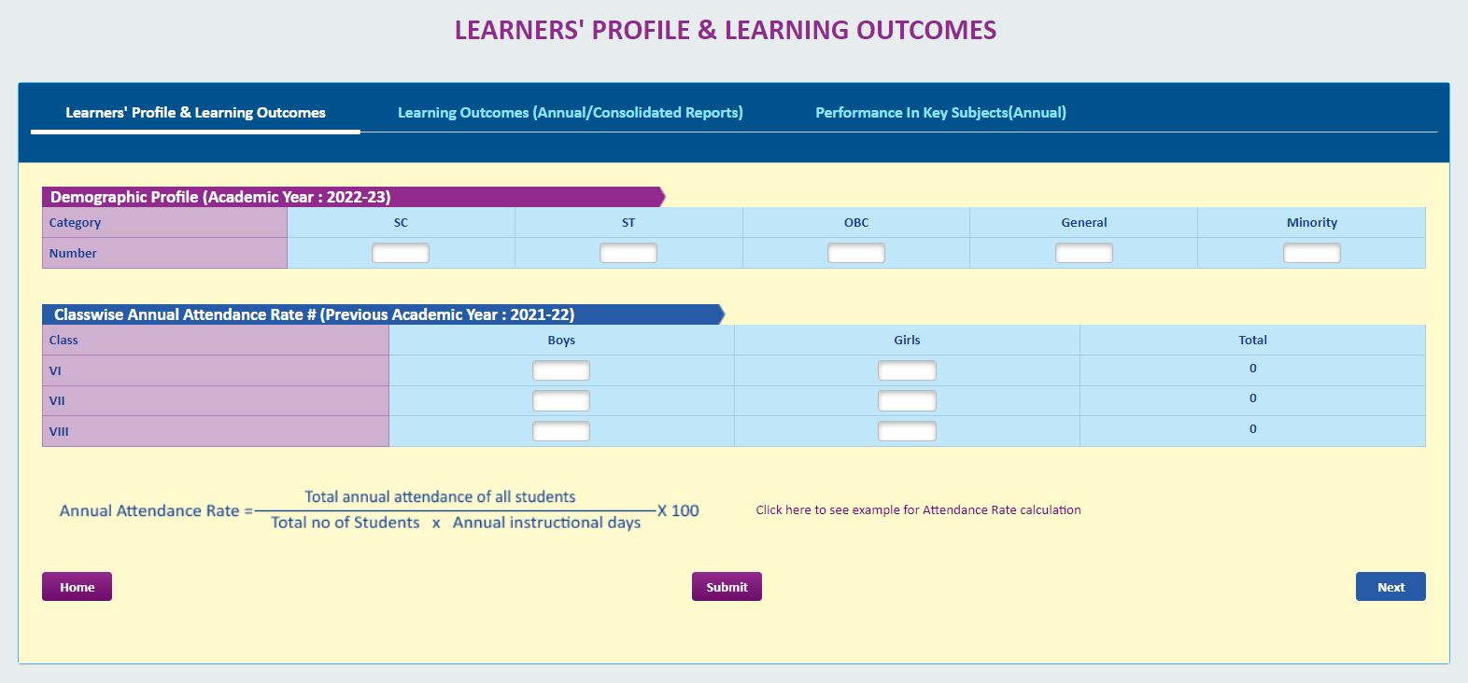
Learners’ - Profile
93.94
Text box zawng zawng hi fill up vek tur a ni.
Entirnan, General students kan nei lo anih pawhin ‘0’ (zero) dah tur a ni.

Slide 6

How to calculate Annual Attendance Rate
EXAMPLE
Instructional Days = 220
Total Annual Attendance of students in Class-VI = 9850
(Boys=30, Girls=20, Total=50)
Annual Attendance of Class-VI Boys = 6200
Total Annual Attendance of Boys / Girls
Average Annual Rate = -------------------------------------------------------------- x 100
Total No. of x Annual Instructional Days
Boys / Girls
Class VI Boys = $\frac{6200}{30 x 220}x 100=93.94$

Slide 7
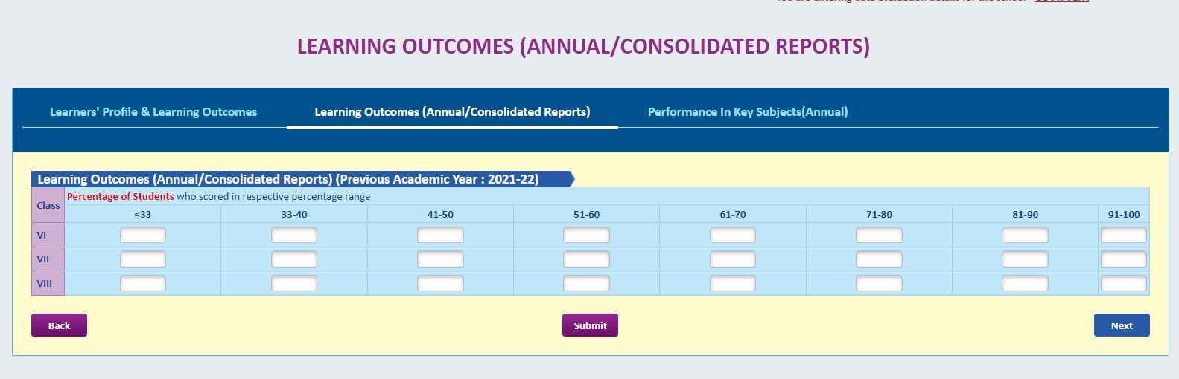
Learners’ - Learning Outcomes
Learning Outcomes-ah hian kum hluia kan dinhmun zel dah tur a ni.
Percentage range awmsa mil zel hian no. of students dah luh tur a ni a, Boys Girls-a thiar a ngai lo.

Slide 8
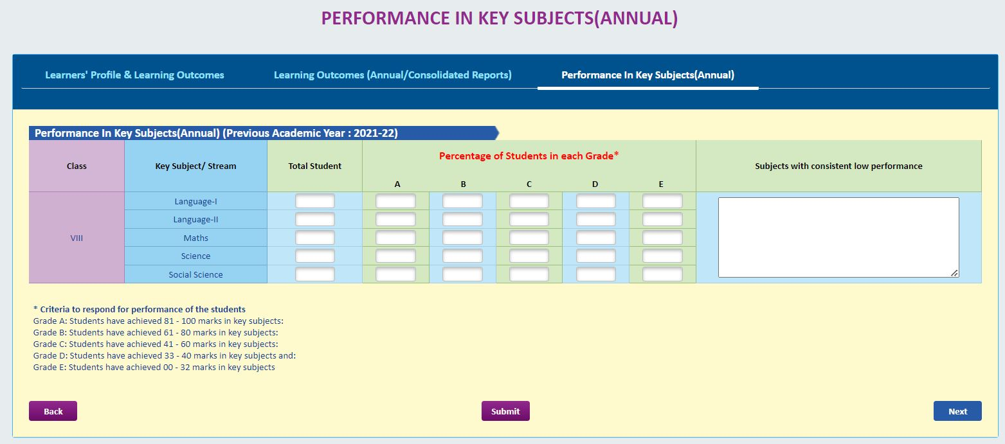
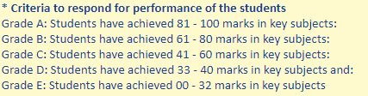
Learners’ – Performance in key subject
VIII
Subject-a performance hniam tak tak nei an awm chuan helaiah hian tarlan tur a ni

Slide 9
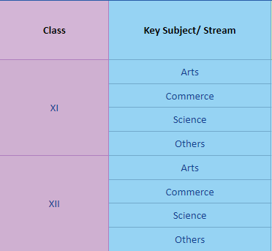
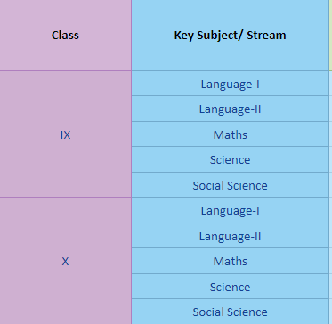
Learners’ – Performance in key subject
XI
IX
XII
X

Slide 10
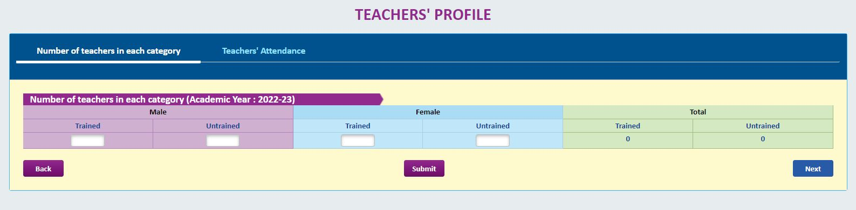
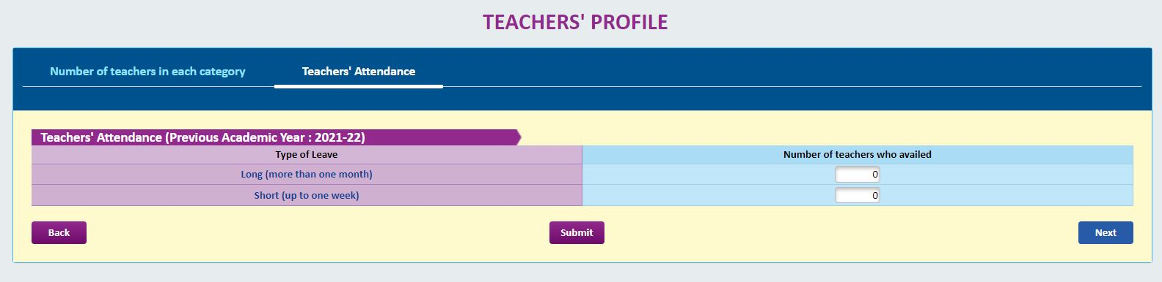
Teachers Profile
1
2

Slide 11
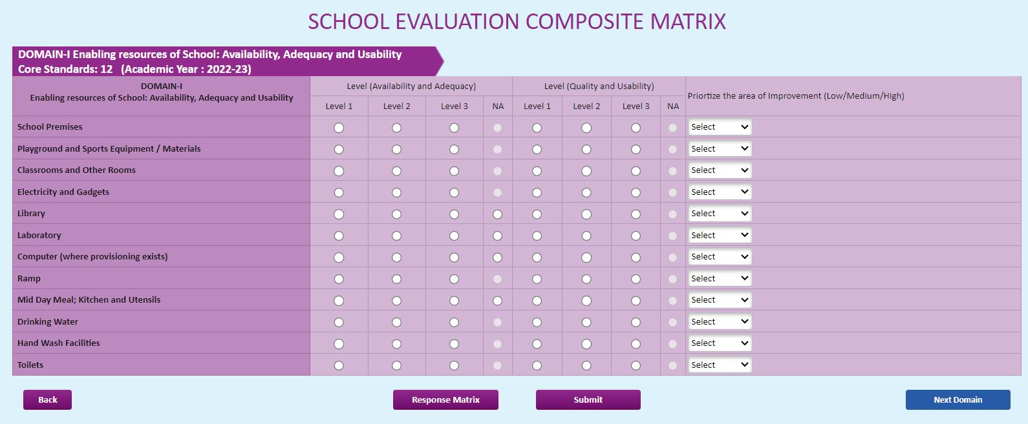
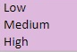

School Evaluation Composite Matrix - (DOMAIN - I)
Enabling resources of School: Availability, Adequacy and Usability
Availability
and
Adequacy
Quality
and
Usability

Slide 12

Example of
Descriptor
Core Standard | Descriptor
 | Level-1 | Level-2 | Level-3
School Premises | Availability and Adequacy
 | Open area is insufficient with limited space for assembly; kuchcha/semipucca/tent type building is available; boundary wall/ fence doesn’t exists or is discontinuous with big gaps; no garden/ trees in the compound | Open and build area is just sufficient with available assembly hall/ space but inadequate to accommodate all learners comfortably; pucca building exists with boundary wall/ fence without gate; few garden/ trees in the compound | Ample open and build spaces available for free movement of learners with designated space for assembly; boundary wall/ fencing with plantation and gate exists; well maintained garden and lawn
 | Quality and Usability
 | Open space is used only for assembly; ground is uneven; premises appear to be unclean and lacking maintenance; major repairs are needed in floor/walls/ roof/ doors/ windows, etc. | Assembly space/ hall is used for organizing other activities such as physical exercises, organizing functions, etc.; ground is even; minor repairs are needed in floor/ walls/ roof/ doors; occasional maintenance is undertaken occasionally | Open space and building are clean and well-maintained; repairs are undertaken in a timely manner

Slide 13
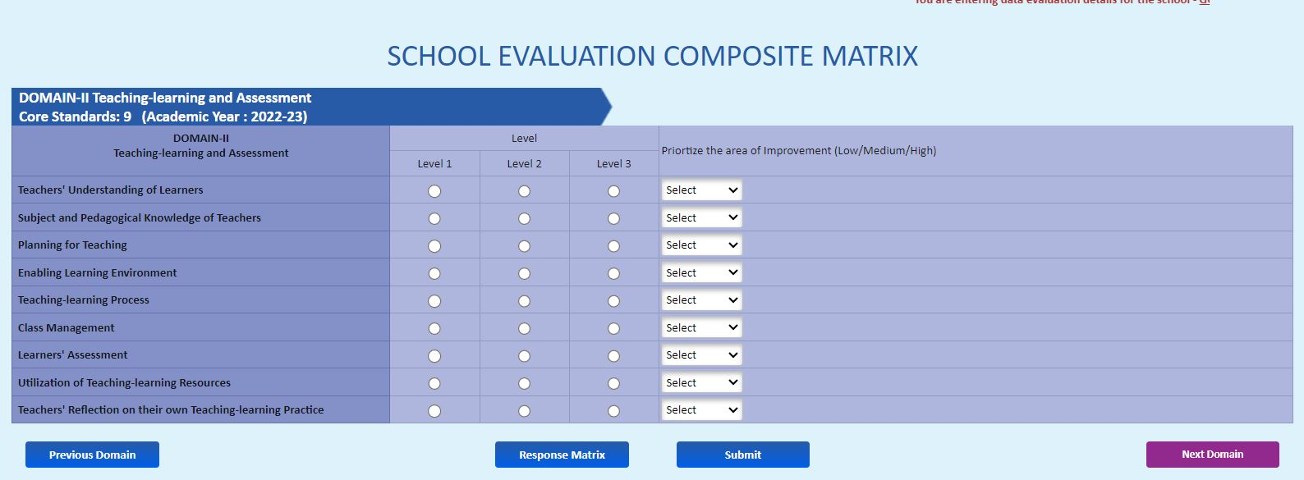
School Evaluation Composite Matrix - (DOMAIN - II)
Teaching-learning and Assessment

Slide 14
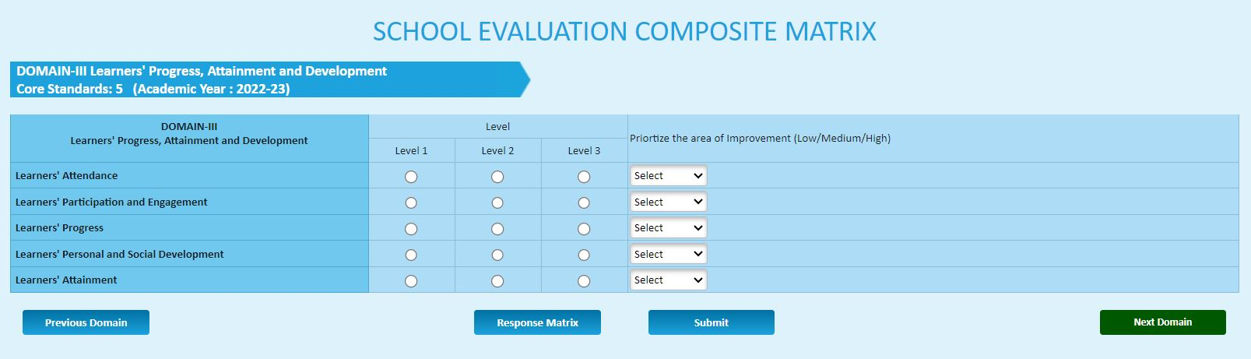
School Evaluation Composite Matrix - (DOMAIN - III)
Learners' Progress, Attainment and Development

Slide 15
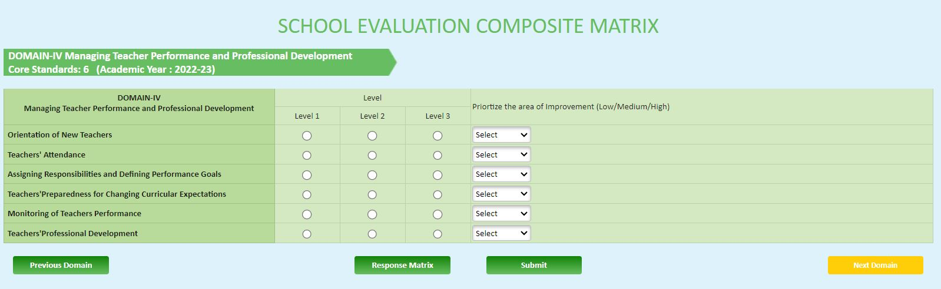
School Evaluation Composite Matrix - (DOMAIN - IV)
Managing Teacher Performance and Professional Development

Slide 16
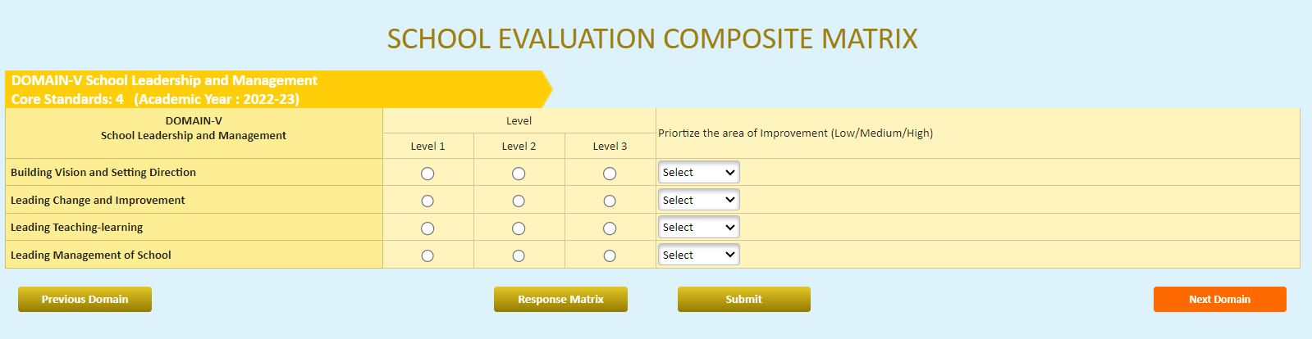
School Evaluation Composite Matrix - (DOMAIN - V)
School Leadership and Management

Slide 17
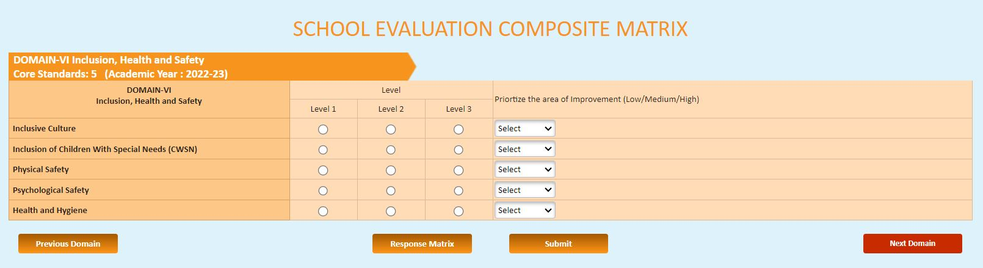
School Evaluation Composite Matrix - (DOMAIN - VI)
Inclusion, Health and Safety

Slide 18
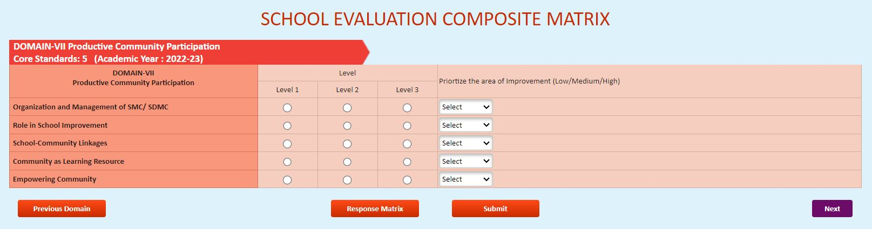
School Evaluation Composite Matrix - (DOMAIN - VII)
Productive Community Participation

Slide 19
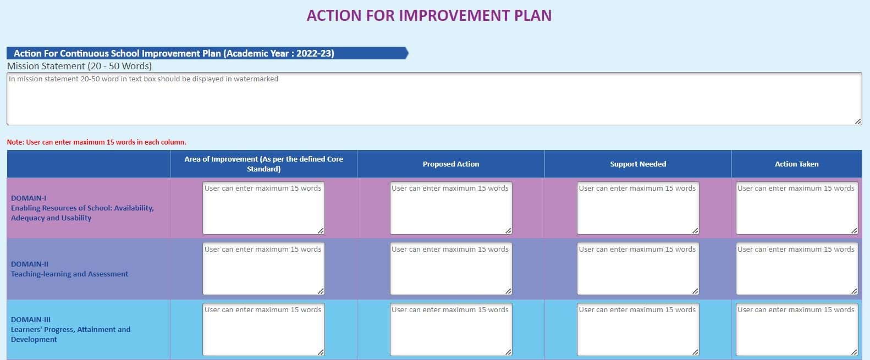
Action for Improvement Plan
DOMAIN - I
DOMAIN - II
DOMAIN - III

Slide 20
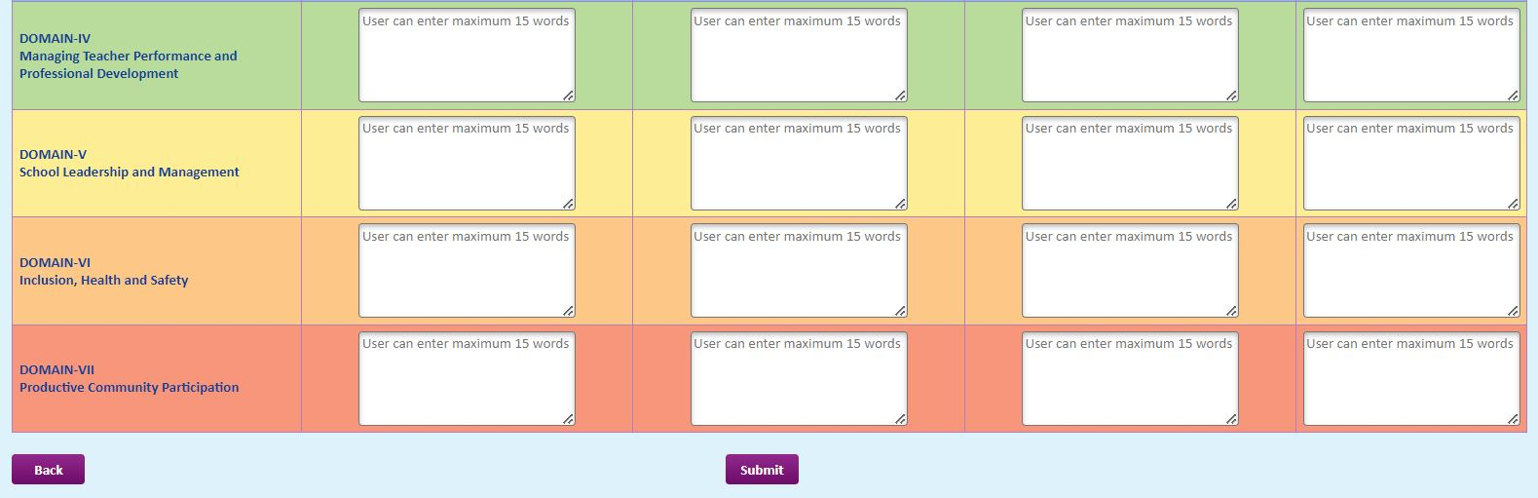
Action for Improvement Plan
DOMAIN - IV
DOMAIN - V
DOMAIN - VI
DOMAIN - VII

Slide 21
Contact Information
District Project Office, Aizawl District
  Pu C. Lalrindika – 8794115049
State Project Office
  Pu Lalhruaitluanga – 9862344397

Slide 22
Samagra Shiksha Mizoram Website
samagra.mizoram.gov.in
&
samagramizoram.nic.in

Slide 23
Thank you

